Slide 1
COMPUTER NETWORKS
CS610
Lecture-6
Dr.M. Sheraz Malik

Slide 2
Review of lecture 5
Byte Stuffing
Transmission Errors
Error Detection
  Parity Check
  Checksum
  CRC

Slide 3
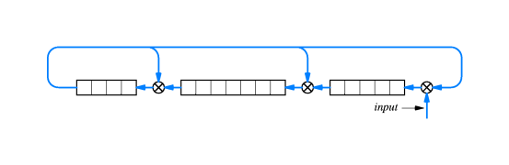
Chapter 7 (cont’d) Combining Building Blocks
Example 16-bit CRC hardware that uses three shift registers and three exclusive or (xor) units

Slide 4
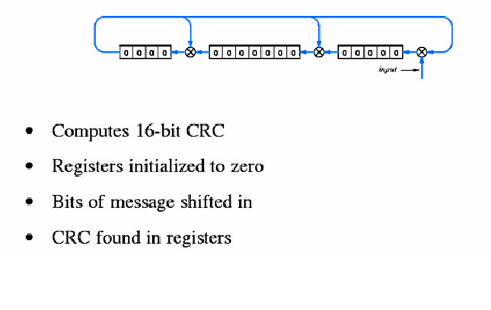
Combining Building Blocks (cont’d)

Slide 5
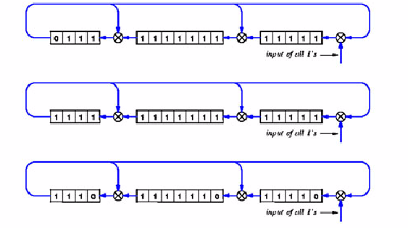
Combining Building Blocks (cont’d)
Input data is all 1s
CRC shown after 15,16,17 bits shifted
Feedback introduces 0s in CRC

Slide 6
DIRECT POINT-TO-POINT
COMMUNICATION

Slide 7
Types of Errors
CRCs can detect the following errors better than checksums
  Vertical errors: Occur due to a hardware failure e.g. Damaged second bit of every character
  Burst errors: Changing a small set of bits near a specific location, caused by lightening, electric motor start, etc.

Slide 8
Frame Format And Error Detection
Modified frame format including CRC
Error in frame typically causes receiver to discard frame
Is Byte stuffing also required for CRC itself?

Slide 9
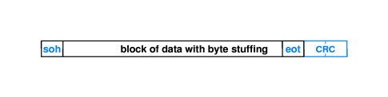
Frame Format And Error Detection

Slide 10
CHAPTER No. 8
LAN TECHNOLOGIES and
NETWORK TOPOLOGIES

Slide 11
Introduction
Most networks are Local and are designed to share resources among multiple computers
Hardware technologies used for Local networks allow multiple devices to connect with a shared network
The computers must take turns using the shared medium

Slide 12
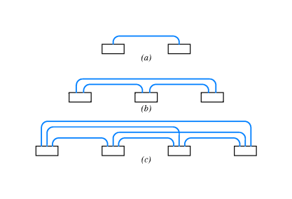
Direct Point-to-Point Communication
Each communication channel connects exactly two computers
Form a MESH or a POINT-to-POINT network

Slide 13
Direct Point-to-Point Communication
Advantages:
  The connection type of individual connections can be different
  Individual connection can choose a different frame format, error detection mechanisms, etc
  Easy to enforce Security and Privacy

Slide 14
Direct Point-to-Point Communication
Disadvantages:
  The number of connections grow more rapidly than the number of computers
    For ‘N’ computers:
Connections = N² - N
  2
  Most connections use the same physical path
  Expensive

Slide 15
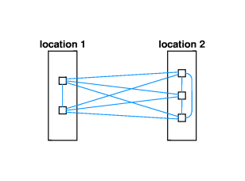
Direct Point-to-Point Communication
Disadvantages:
  Adding a new computer to the network requires ‘N-1’ new connections

Slide 16
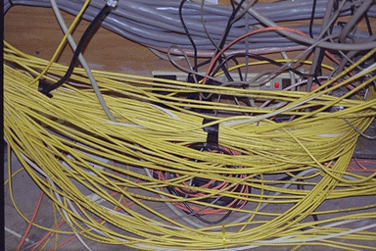
Star Topology in Practice
The Result is:

Slide 17
Summary
CRC Hardware Components
Frame Format and CRC
LAN technology and Network topology (Chapter 8)
Direct Point-to-Point Communication

